Slide 1
FCAT Review
Cells and Body Systems

Slide 2
What does “Being Alive” mean?
Made of cells
Respond to stimuli
Respire (use energy)
Adapt
Reproduce
Excrete wastes
Secrete
Have a life span

Slide 3
What are living things?
What do you think it means to be alive?
Organism- any living thing

Slide 4
Living things are Organized
Made of cells
Cells- is the smallest unit of an organism that carries on the functions of life.
Organisms can be composed of one or many cells.
Cells have orderly structure and they contain hereditary material which is the instruction for the cells structure and function

Slide 5
Cell Theory
Theory | Example
1. All organisms are made up of one or more cells | All organisms can be one cell or many cells like a bacteria or animal
2. The cell is the basic unit of organization in organisms | Even in complex organisms the cell is the basic unit of structure and function
3. All cells come from cells | Most cells can divide to form two new identical cells

Slide 6
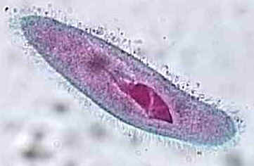
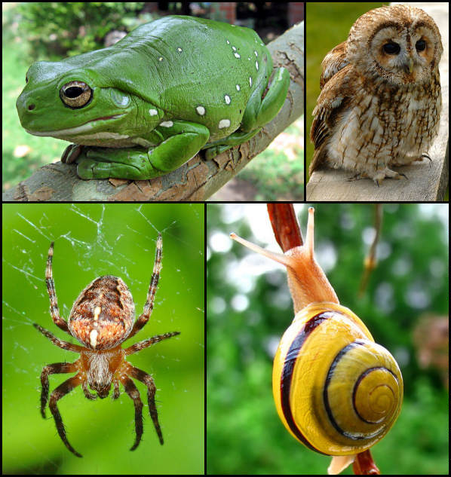
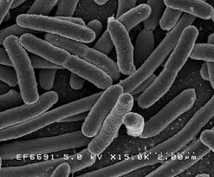
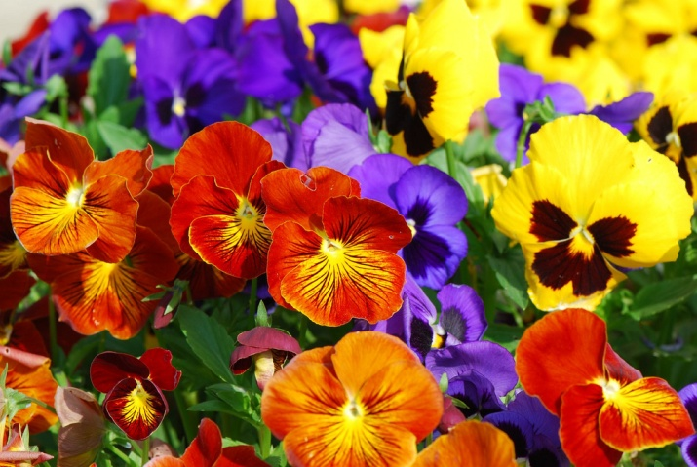
Single Cell vs. Multicellular Organisms

Slide 7
Prokaryotic VS Eukaryotic
Prokaryotic cells- single celled organism such a bacteria, it does NOT have any organelles, only cell membrane, cytoplasm, and hereditary material
Eukaryotic cells- found in multicellular organisms. Has organelles, is either plant or animal. Has specialized cells for different jobs within the organism

Slide 8
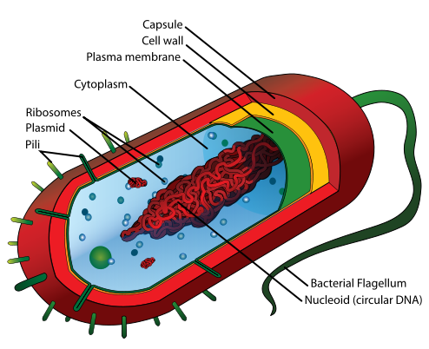
Structure of the Prokaryotic Cell

Slide 9
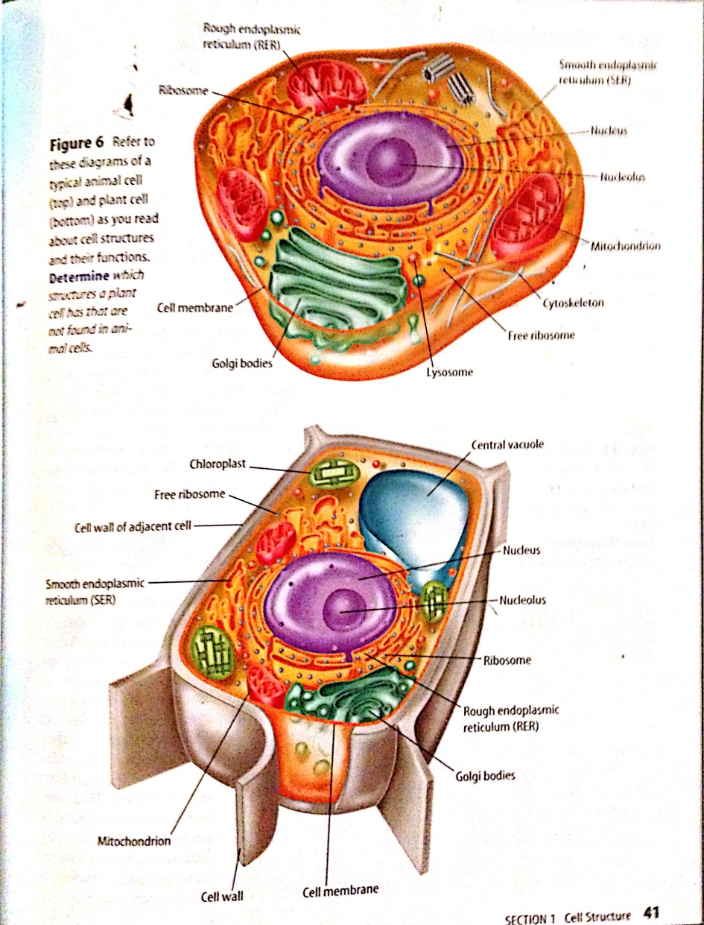
Structure of the Eukaryotic Cell
Animal cells are shown as round cells
Plant cells are shown as square cells
They have a lot of organelles in common

Slide 10
Organelles
Organelles- “tiny organs” of a cell
They function very similarly to the organs in our bodies to keep the organism functioning properly
Homeostasis- an organisms ability to keep proper conditions inside no matter what is going on outside

Slide 11
Organelles
Organelle | Function (Job) | Animal/Plant
Cell Wall | Tough, rigid outer covering | Plant
Cell Membrane | Protective layer around the cell | both
Cytoplasm | Gelatin-like material that is in the cell where all the organelles carryout their functions | both
Nucleus | Directs all cell activity (like a brain), houses the DNA | both

Slide 12
Organelles
Organelle | Function (Job) | Animal/Plant
Chloroplasts | Contain chlorophyll which makes them green, this is where photosynthesis happens | Plant
Mitochondria | Where energy is from break down food (cellular respiration happens) | both
Ribosome | Make proteins that are used for many other functions by the cell | both
Vacuole | Storage area for food, water, waste Central Vacuole ( large storage area for water in plant cell only) | both

Slide 13
Animal VS Plant Cell
Animal | Plant
Round shaped | Square Shaped
Cell Membrane is outer covering | Has cell wall
Has lysosomes | Central Vacuole
 | Chloroplasts (with chlorophyll)

Slide 14
Cell Organization small to big
Atom
Molecule
Organelle
Cell
Tissue
Organ
System
Organism

Slide 15
Cells are specialized
We have millions of cells in our bodies.
There are several types of cells which perform different jobs to keep us alive
These specialized cell make special tissues that create specialized organs
The organs working together to perform tasks are called organ systems
Each organ system carries out a specific function

Slide 16
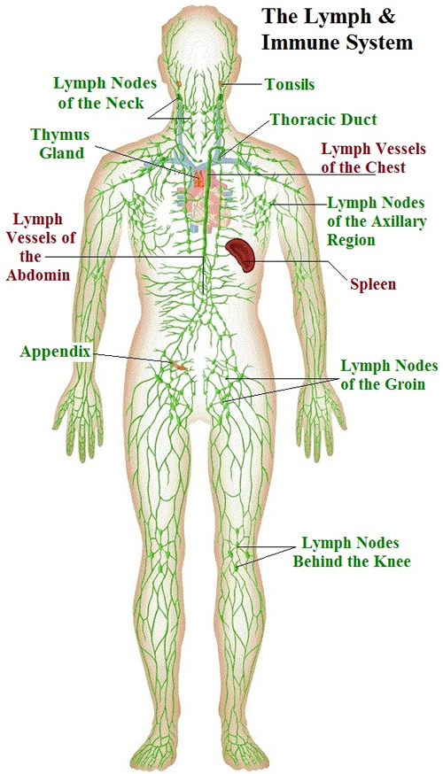
Major Systems
Respiratory- takes in oxygen to put it in the blood for respiration and gets rid of carbon dioxide waste
Digestive-
Brings in food and takes out nutrients then gets rid of the waste
Immune- protects you from illness/ bacteria
Excretory-
Gets rid of waste in the blood

Slide 17
Major Systems
Skeletal- provides framework for the body, attachment for muscles to move the body, and makes blood in the marrow
Nervous- allows you to respond to stimuli to maintain homeostasis, all of your senses are part of the nervous system
Circulatory-
Heart pumps oxygenated blood through arteries to the rest of the body and veins return it to the heart
Muscular-
Allows for voluntary movement of the body and pumps blood, moves food, and blood through involuntary movement

Slide 18
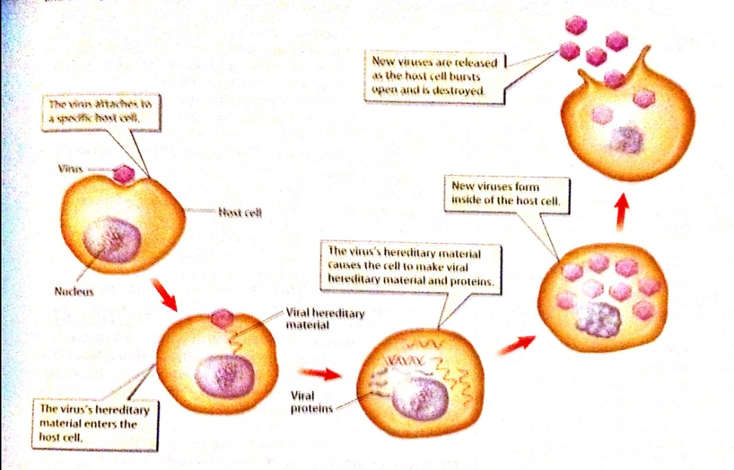
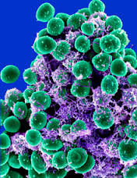
Bacteria VS Virus
Bacteria are single celled organisms
They are alive
They can live outside of host body
They can respond to stimuli and reproduce
Killed with
antibiotic (pill)
Virus is not an organism
It cannot reproduce with a host cell of a living organism
Killed with a vaccine (shot)

