Slide 1
FCAT REVIEW
Physical Science: Force and Energy

Slide 2
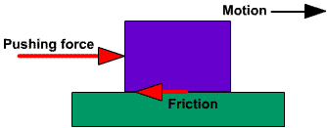
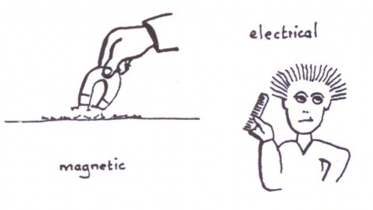
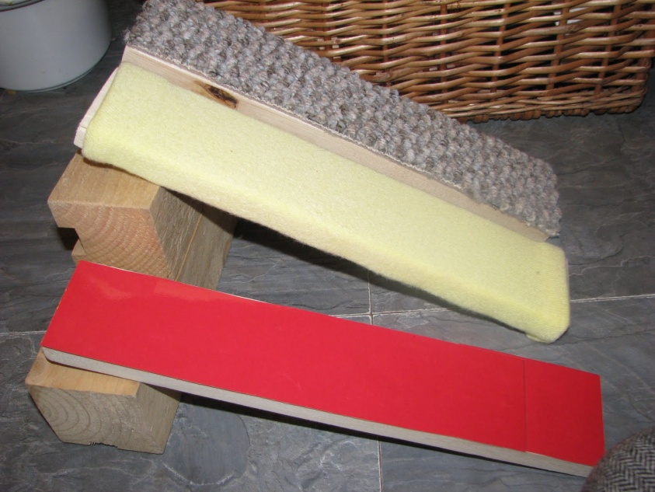
Force and Motion
A force is a push or pull that starts, stops, or changes the direction of an object.
Some examples of contact forces are gravity and friction.
Some examples of non-contact forces are magnetism and electricity.
Gravity keeps the planets in orbit around the sun.
Friction can slow down and stop objects in motion.

Slide 3
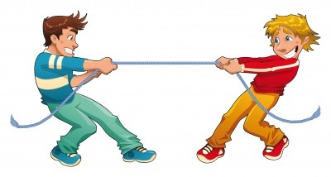
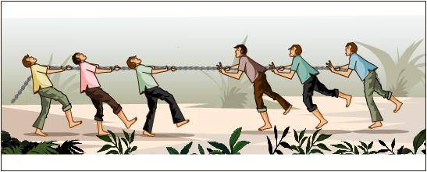
Force and Motion
Forces can be balanced or unbalanced.
Unbalanced forces cause an object to start moving (accelerate) but balanced forces do not.

Slide 4
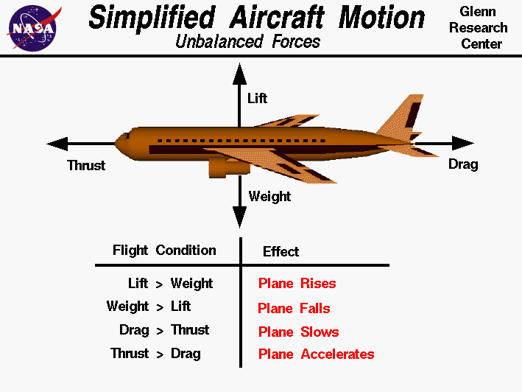

Slide 5
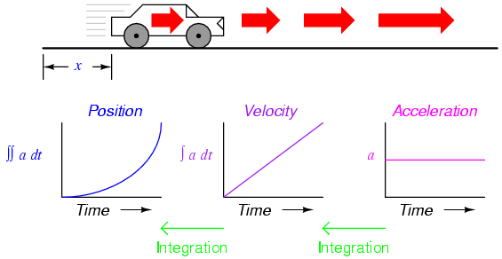
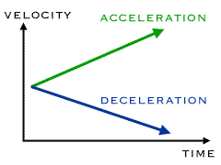
Force and Motion
Speed is how fast an object is moving.
Speed and velocity are very similar and are often used interchangeably.
Acceleration is the rate at which an object’s velocity changes.
Positive acceleration values mean that an object is speeding up
Negative acceleration values mean that an object is slowing down.
Negative acceleration is often called deceleration.

Slide 6
Energy
Energy is the ability to cause change or do work.
There are six main types of energy: mechanical, nuclear, electrical, chemical, electromagnetic, and thermal.
The mechanical energy of a moving object is called its kinetic energy.
The mechanical energy of an object due to its position is called its potential energy.

Slide 7
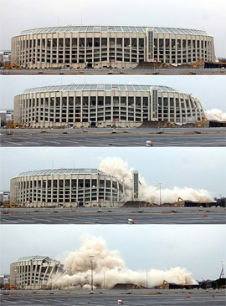

Potential Energy
Potential energy is the energy that results from the position or shape of an object.
Any object no matter its size has the potential to fall (mechanical energy). THAT IS THE OBJECTS POTENTIAL ENERGY!

Slide 8
Kinetic and Mechanical Energy
Kinetic energy is the energy that results from the motion of an object.
Anything in motion and moving has kinetic energy.
Mechanical energy is energy associated with the position, shape, or motion of an object and is made up of kinetic and potential energy.
Force
Kinetic energy

Slide 9
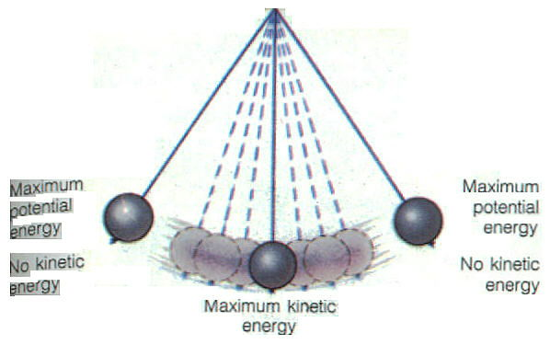
Energy

Slide 10

Types of Energy
  Mechanical Energy – Kinetic energy or matter that is moving.
  Thermal Energy- kinetic and potential energy of particles
  Electric Energy- energy carried in the eclectic charges of particles
  Electromagnetic Energy- travels through space in waves
  Chemical Energy- potential energy stored in chemical bonds

Slide 11
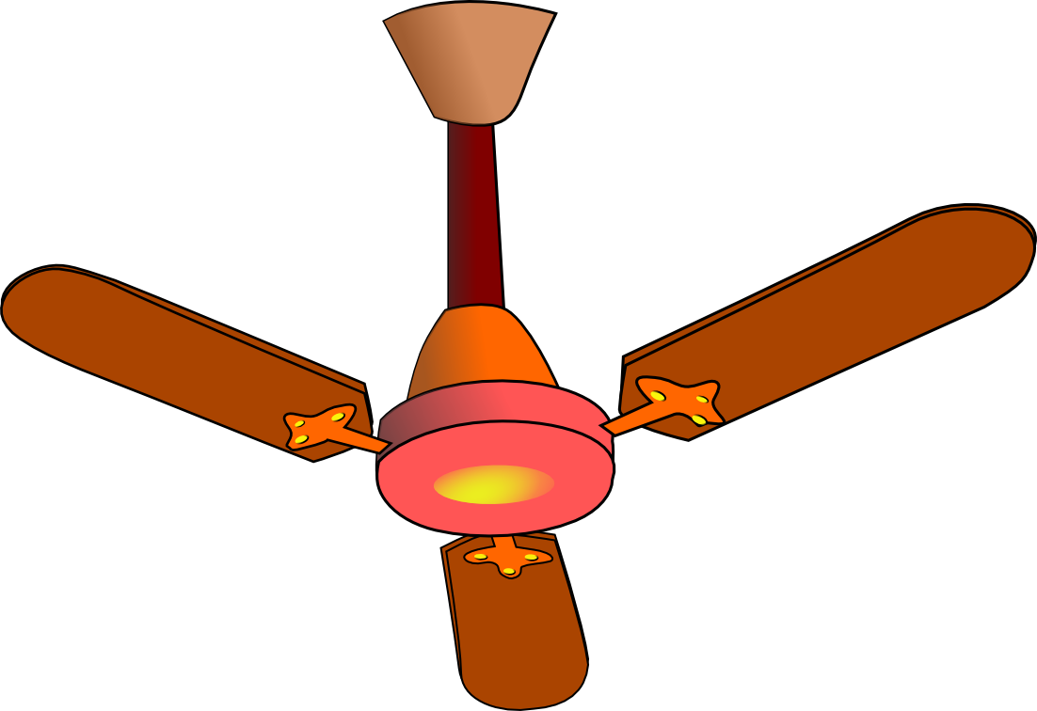
The Law of Conservation of Energy
Energy is constantly changing from one form to another.
As energy changes from one form to another, it is never created or destroyed.
Many times it takes a whole series of energy conversions to do a certain job.
For example, just to get the energy to make a piece of toast, there are several energy conversions involved.
  Chemical energy stored in coal is released as heat and light energy when the coal is burned.
  The heat energy is used to produce steam and is changed into mechanical energy in a generator.
  The generator converts mechanical energy into electric energy that travels through power lines into your home.
  When you use your toaster, that electric energy is again changed into heat/thermal energy.

Slide 12
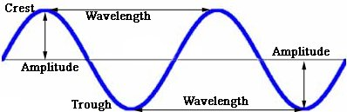
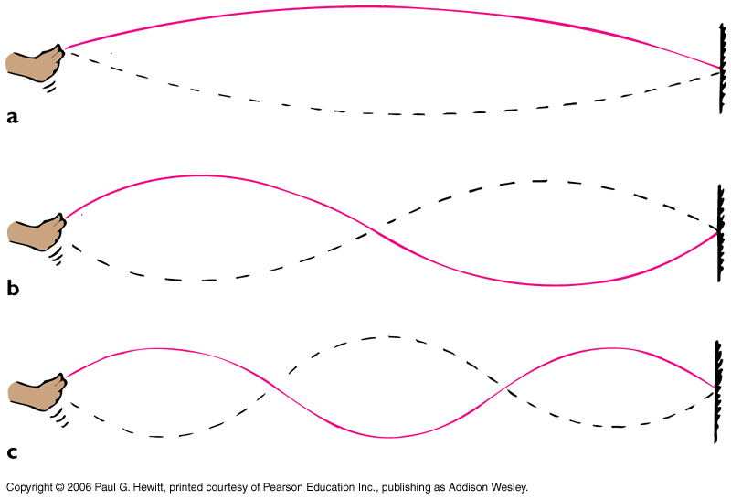
Waves, Sound, and Light
All waves have a wavelength, amplitude, frequency, and speed.
The wavelength is the distance between two consecutive crests or troughs.
The amplitude of wave is the vertical distance between the line of origin (middle) and each crest or trough.
The frequency of a wave is the number of wavelengths that pass a point in a given amount of time.
The speed of a wave is equal to the frequency times the wavelength.

Slide 13
Waves, Sound, and Light
A wave is a disturbance that transfers energy through matter or through space.
Mechanical waves move through a medium which can be a solid, liquid, or gas.
Sound waves, water waves, and earthquakes are all mechanical waves.
Light waves travel faster than sound waves
  E.g. Lightning strike is seen before thunder is heard.
Electromagnetic waves do not require a medium.
Light waves are electromagnetic waves.
Thus, light can travel through the vacuum of outer space but sound cannot.
Sound waves need matter to travel.

Slide 14
The Electromagnetic Spectrum
CHARACTERISTICS OF ELECTROMAGNETIC WAVES
An electromagnetic wave is a disturbance that involves the transfer of electric and magnetic energy.
An electromagnetic wave is made up of vibrating electric and magnetic fields that move through space or some medium at the speed of light.
ENERGY
The energy that electromagnetic waves transfer through matter or space is called electromagnetic radiation.
The sun’s energy arrives on Earth as electromagnetic radiation.
All electromagnetic waves travel at the same speed in a vacuum, but they have different wavelengths and different frequencies.

Slide 15
The Electromagnetic Spectrum
The electromagnetic spectrum is the complete range of electromagnetic waves placed in order or increasing frequency.
  Running Madly In Very Unusual Xtreme Games
Radio-used in broadcasting to carry signals for radio programs.
Microwaves- have shorter wavelengths and higher frequencies than radio waves do.
  E.g. Microwave ovens are used to heat food
Infrared – invisible heat you feel (e.g .warming by a campfire)
Visible- Electromagnetic waves you see.
  WHITE LIGHT
  Visible light that appears white is actually a mixture of many colors.
  Light waves bend, or refract when they enter a new medium.
  So, when white light passes through rain drops, a rainbow can result

Slide 16
Ultraviolet- these rays have higher frequencies than visible light, so they carry more energy.
  Ultraviolet rays can damage or kill living cells.
  Small doses of ultraviolet rays are useful; for instance, they cause cells to produce vitamin D.
X-Rays- carry more energy than ultraviolet rays and can penetrate through most matter.
  Dense matter, such as bone or lead, absorbs X-rays so they can pass through.
  Thus, X-rays are used to make images of bones and teeth
Gamma Rays- have the greatest amount of energy; the most penetrating of electromagnetic waves.
.

Slide 17
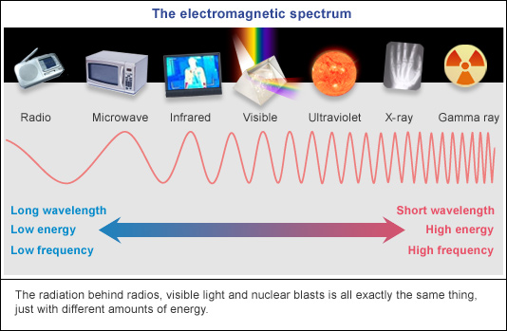
The Electromagnetic Spectrum

Slide 18
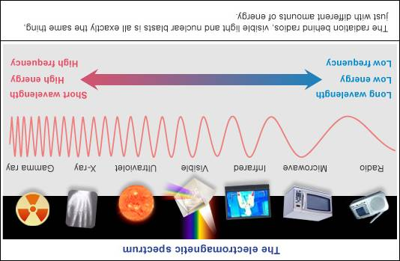
Electromagnetic Spectrum
A
B
Which wave image (A or B) is accurate? Using the terms “wavelength” and “frequency” describe the trends in the waves within the EM Spectrum.
SC.8.E.5.11

Slide 19
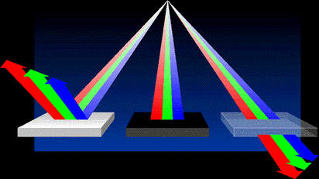
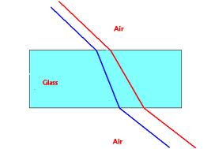
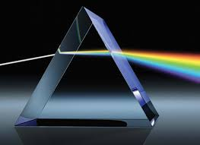
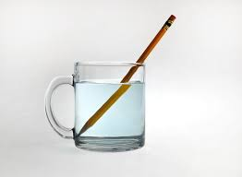
Waves in different materials
There are three kinds of wave interactions, reflection, refraction, and absorption.
Refraction: Light bending
  The speed of a wave through a substance is determined by the substance’s physical properties.
Some substances will cause the light to move at a slower speed than it will through other substances.

Slide 20
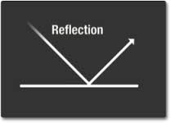
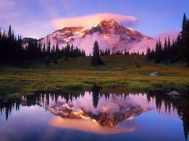
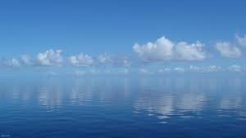
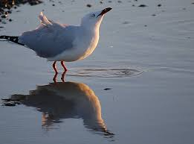
Waves, Sound, and Light
Reflection occurs when a wave bounces off a surface.

Slide 21
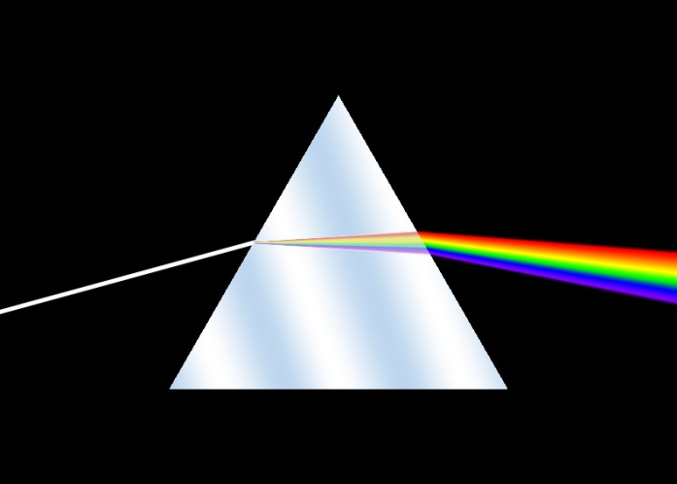
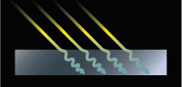
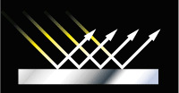
Reflect, Refract, Absorb
A
C
B
Label the images above with the correct term concerning the motion of light waves.
SC.7.P.10.2

Slide 22
What are the three ways heat is transferred
Convection
  The heat transfer that occurs only in fluids such as air and water.
  Convection currents- warmer less dense material rises, cooler more dense material falls
Conduction
  Transfers heat from one particle of matter to another within or between two objects.
  Touch
Radiation
  The transfer of energy by electromagnetic waves.
  Does not need matter to transfer, can transfer through space.

Slide 23
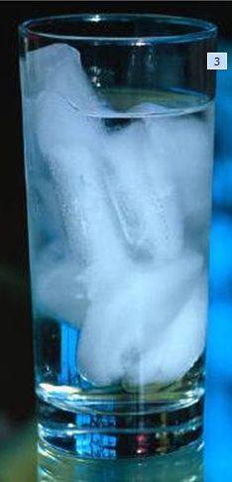
HEAT/Thermal energy transfer
The warm air from the room is transferring to the cooler water.
The water is transferring thermal energy to the cooler ice.
These transfers of energy from warm to cool will continue until the ice is melted and the water is the same temperature as the room.
Heat is the transfer of energy from a warmer object to a cooler object.
Heat will continue to transfer until both objects are the same temperature.

Slide 24
Sample Question
What is the source of energy used in photosynthesis?
  A. Glucose
  B. Sunlight
  C. Chlorophyll
  D. DNA

Slide 25
Sample Question
What type of radiation represents the color spectrum seen on Earth?
A. gamma rays
B. infrared
C. visible
D. X-ray

Slide 26
Sample Question
While attending a baseball game of his favorite major league team, Takahiro notices that he can see the batter hit the ball before he hears the crack of the bat. Which of the following statements best explains why there is a time lapse between seeing the baseball hit and hearing it?
A. Eyes react to stimuli faster than ears do
B. Light waves travel in a more direct path than sound waves.
C. Sound waves travel more slowly in the air than light waves do.
D. Sound waves from other sounds cause interference with sound waves from the bat.

Slide 27
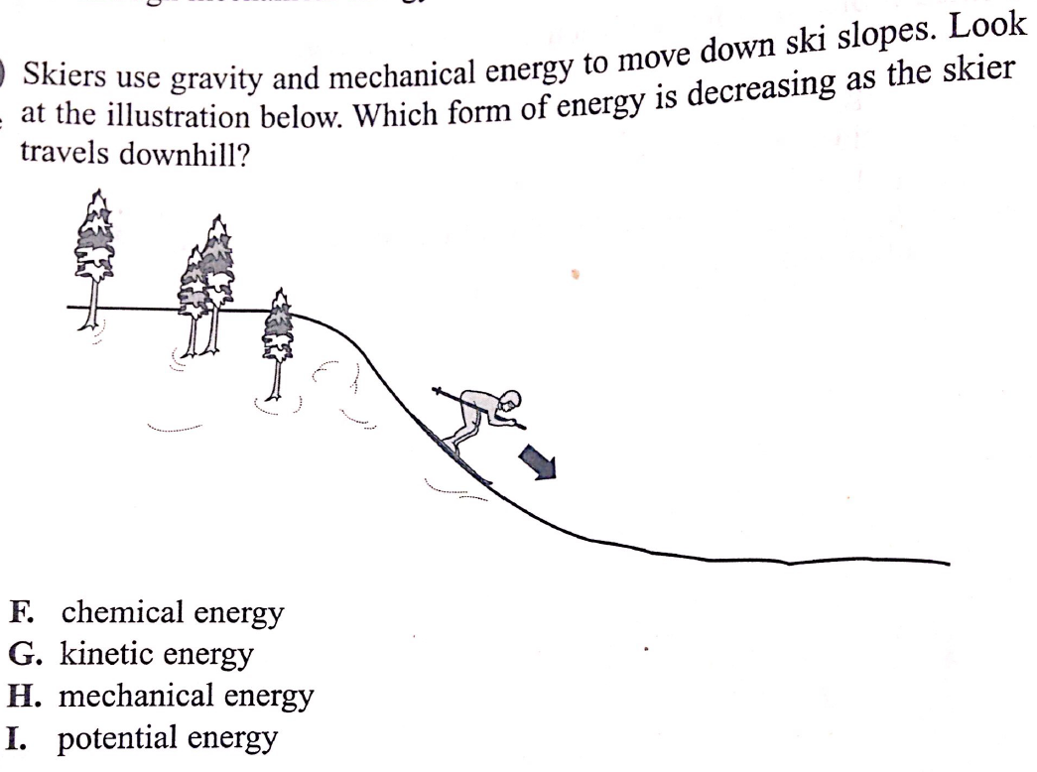
Sample Question

Slide 28
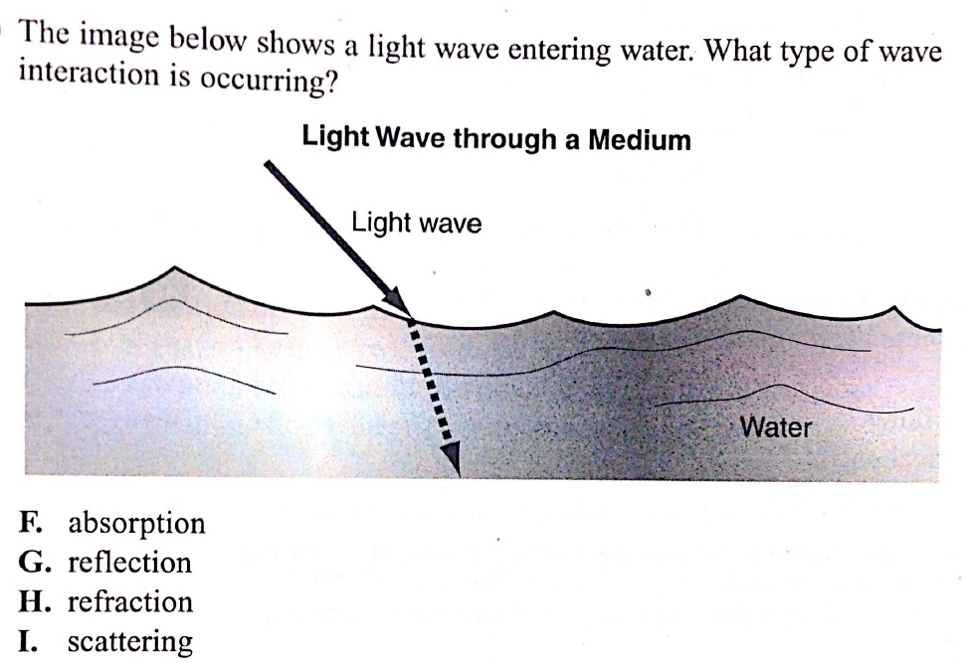
Sample Question

Slide 29
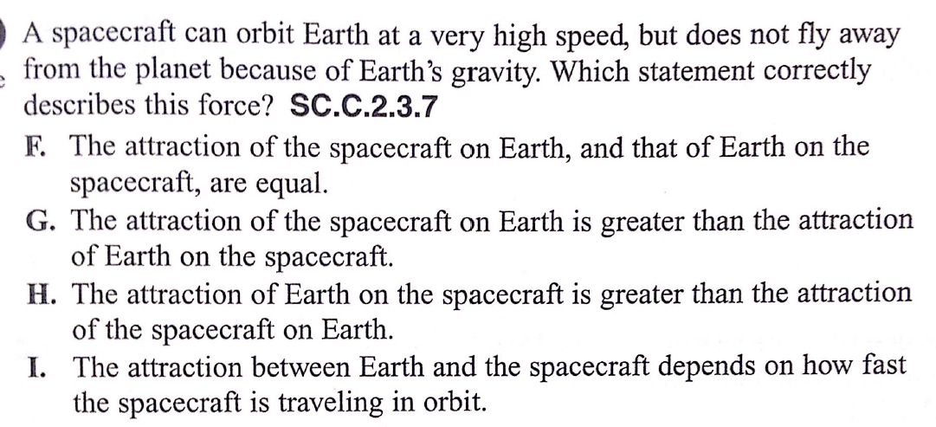
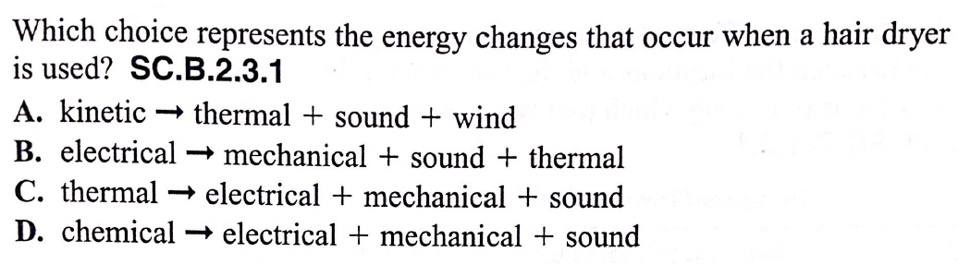
Sample Question

Slide 30
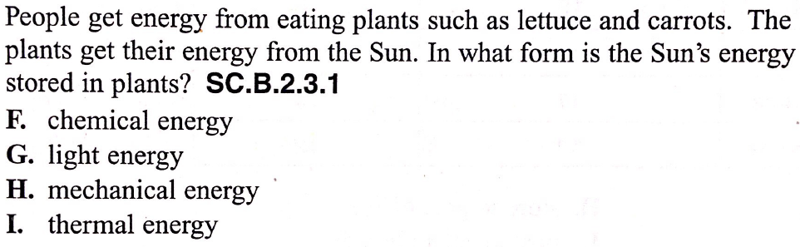
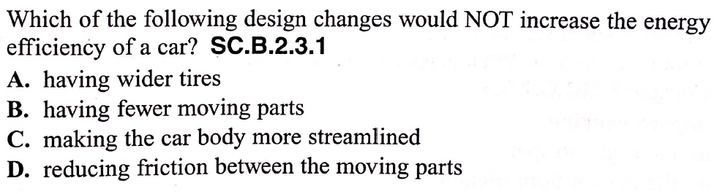
Sample Question

Slide 31
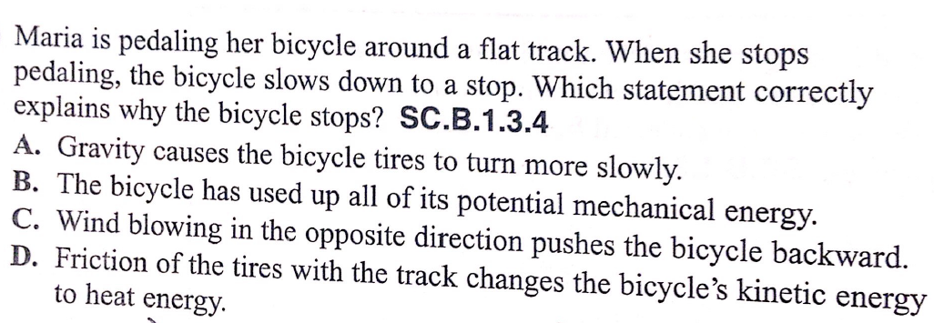
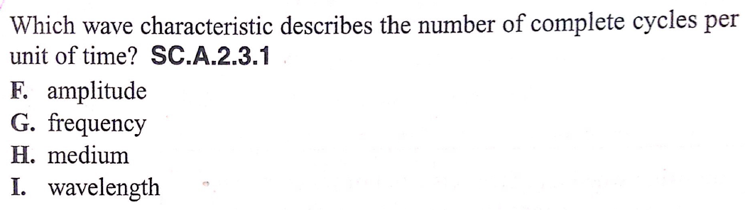
Sample Question

Slide 32
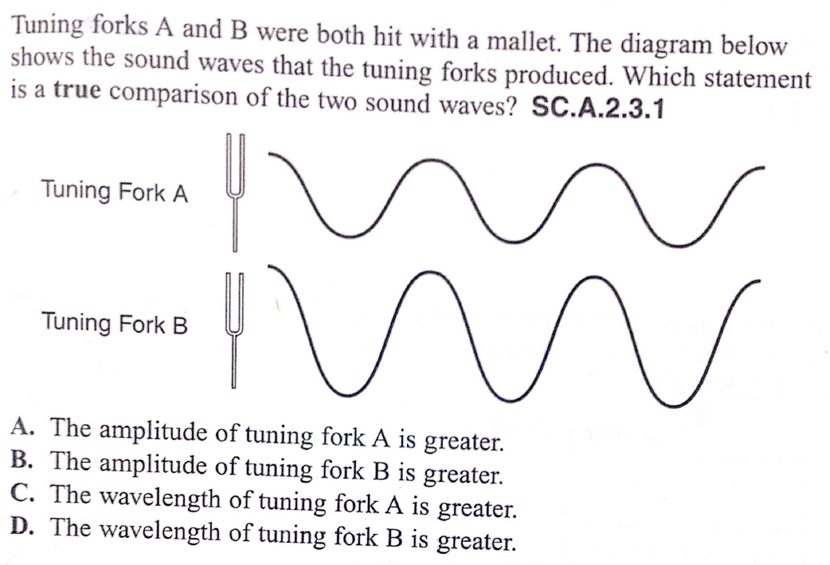
Sample Question

Slide 33
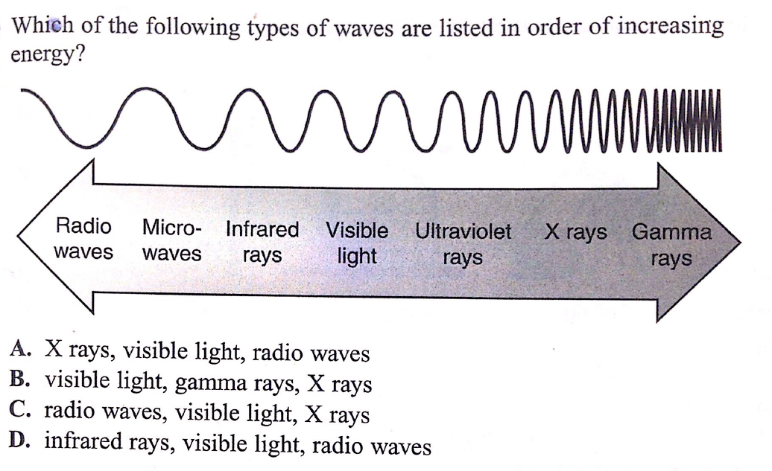
Sample Question

Slide 34
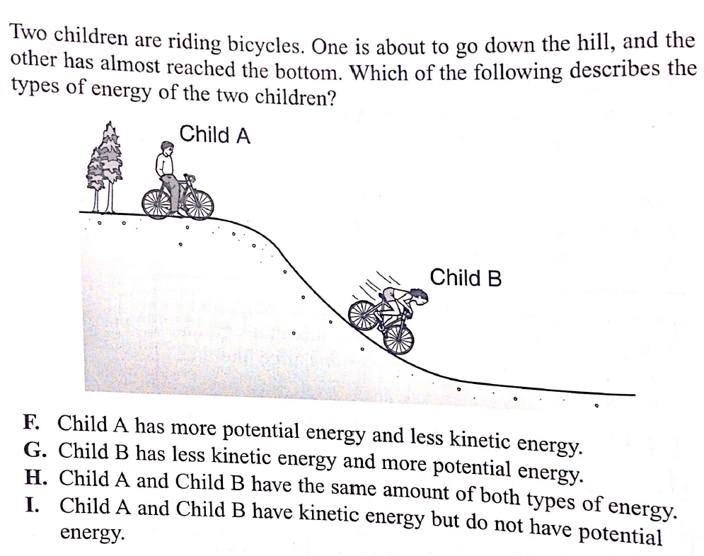
Sample Question

Slide 35
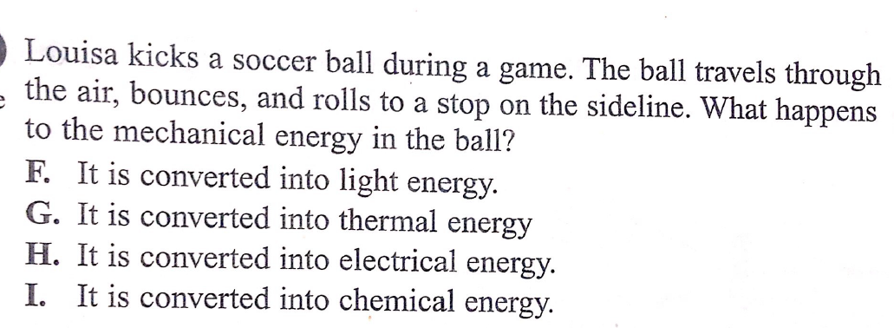
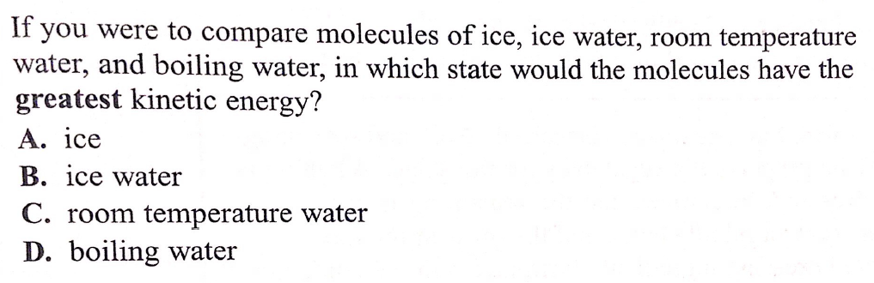
Sample Question

Slide 36
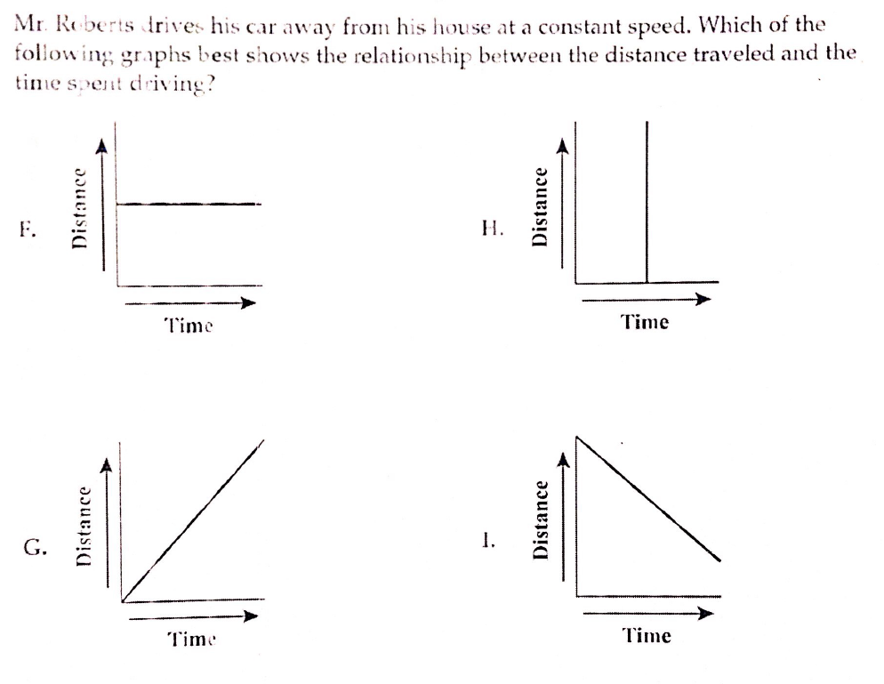
Sample Question

Slide 37
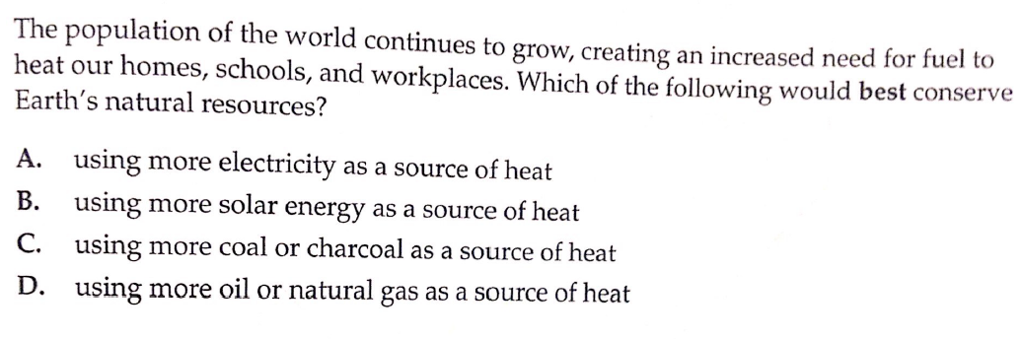
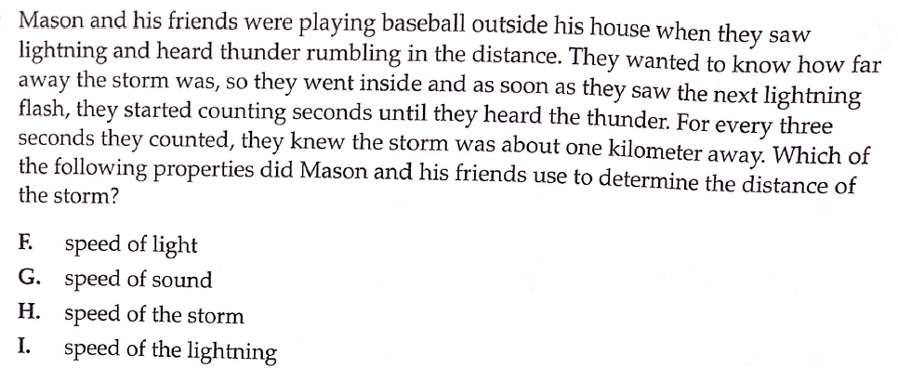
Sample Question

Slide 38
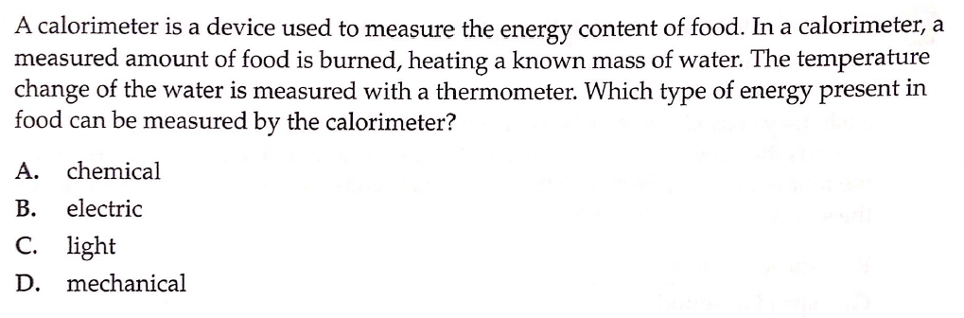
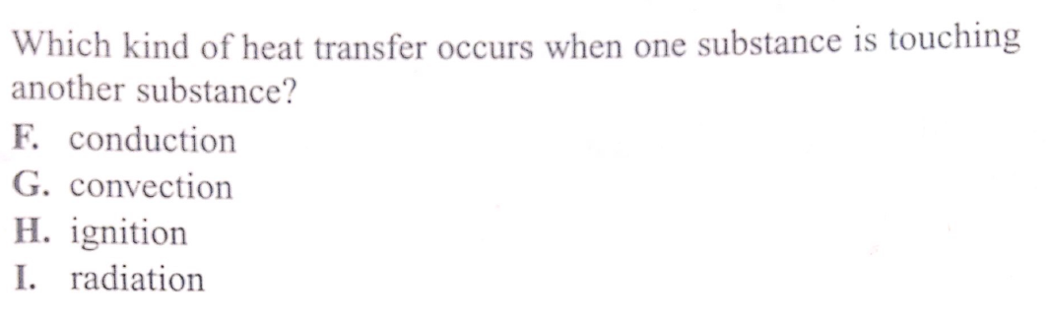
Sample Question

