Slide 1
FCAT Review Earths’ Systems

Slide 2
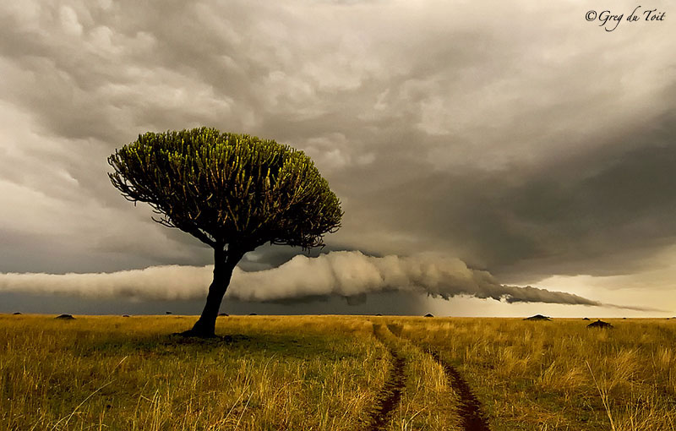
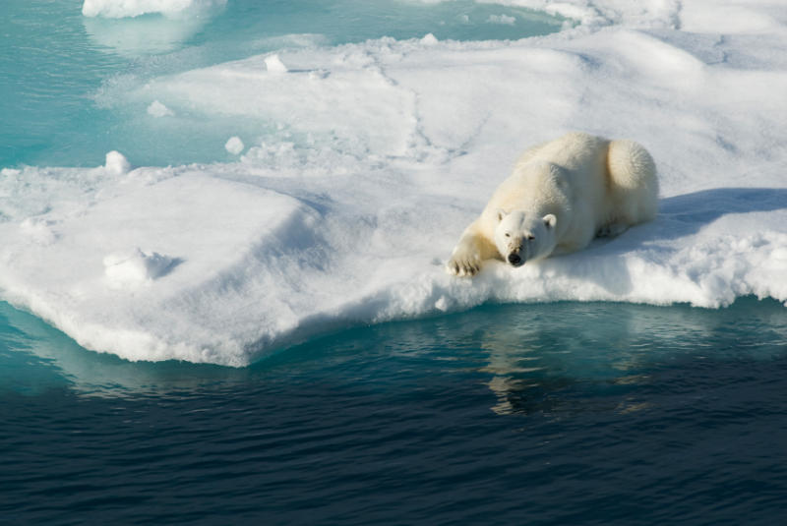
Parts of Earths’ Systems
The Earth system has 5 main spheres:
1) Atmosphere
The envelope of gases that forms Earth’s outermost layer.
It is a mixture of gases- mostly nitrogen and oxygen.
It contains Earth’s weather; the atmosphere is the foundation for the different climates around the world.
2) Geosphere
3 parts: metal core, solid middle layer, and rocky outer layer.
Nearly all of Earth’s mass is found in Earth’s solid rocks and metals.
3) Hydrosphere
Earth’s water
¾ Earth is covered by water.
4) Cryosphere
Consists of all water in the form of ice: glaciers, ice caps, frozen ground, etc.
Glaciers affect Earth’s geosphere by grinding and eroding rock.
5) Biosphere
Parts of Earth that contain living organisms (us!)

Slide 3
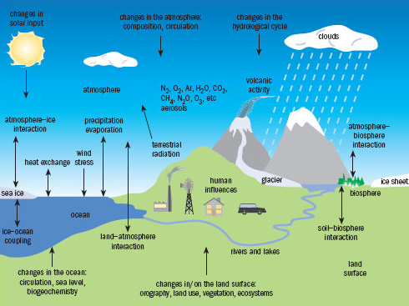
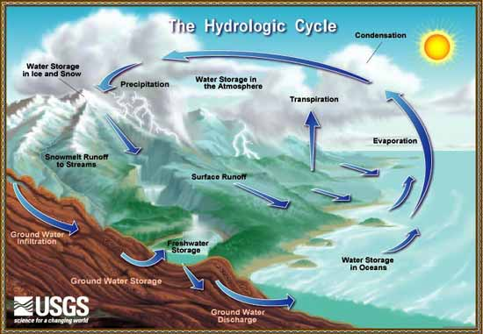
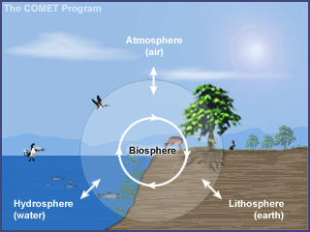
Different Earth system Interactions

Slide 4
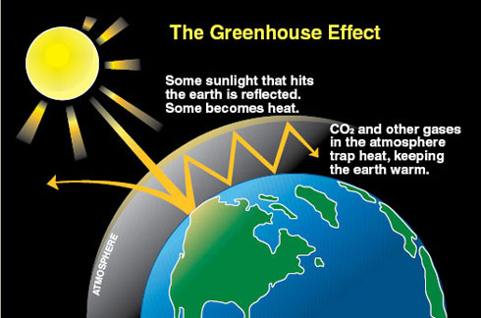
Atmosphere
The atmosphere is held around Earth because of gravity
The Atmosphere keeps earth’s surface warm through a process called the greenhouse effect.
Earth’s atmosphere serves as insulations; it keeps in heat that comes in from the sun.

Slide 5
Layers of the Atmosphere
Name of Layer | Altitude in (km) | Characteristics of the layer
Troposphere | (0-16 km) | Layer nearest Earth All weather happens here More than half of the total mass of the atmosphere within this layer Temperature drops as altitude increases
Stratosphere | (16 km – 50 km) | Most jets fly in this layer Protective ozone layer is at the top of this layer Jet stream is in this layer Temperature goes up with altitude
Mesophere | (50 km – 90 km) | Meteors burn up here Radio waves reflect to earth in this layer This is the coldest layer
Thermosphere (Ionosphere)-lower part | (90 km – 300 km) | happen in the lower part of this layer Hottest layer in the atmosphere
Exosphere | (300 km – 600 km) | Satellites orbit in this layer Outermost layer Temperature goes up with altitude

Slide 6
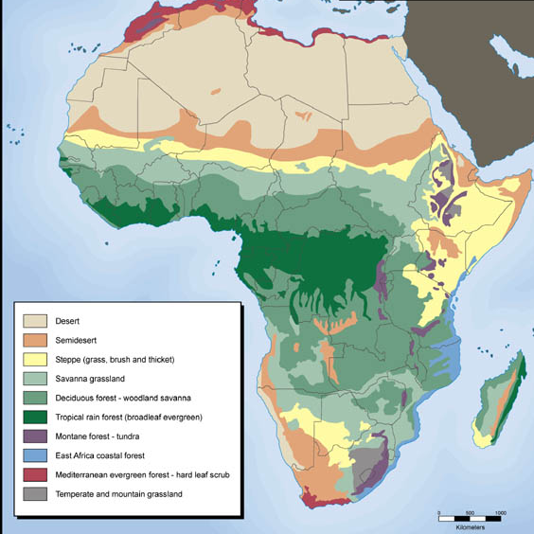
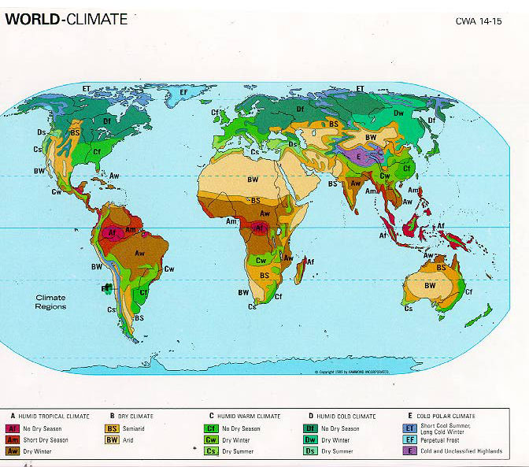
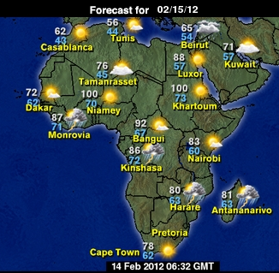
Weather Vs. Climate
Weather
The condition of Earth’s atmosphere
at a particular time and place. As
interactions between parts of the Earth
system change, so does the weather.
CLIMATE
The average annual conditions of temperature, precipitation, winds, and clouds in an area.
The difference between weather and climate is that weather refers to the atmospheric conditions at a particular point in time, while climate refers to average, year-after-year weather patterns over an extended amount of time.

Slide 7
Types of Heat Transfer
Heat transfer
Convection- the transfer of heat my movement of a fluid (usually liquids and gases).
In fluids, atoms and molecules can move easily from one place to another.
As they move; their energy moves along with them.
Conduction- transfer of heat between 2 substances that are in direct contact.
E.g. Heat being conducted between the grate and (stove top) and the pot.
Radiation- the direct heat of energy by electromagnetic waves.
E.g. Heat you feel from the sun travels to you as infrared radiation.
E.g. Warming yourself by a campfire.

Slide 8
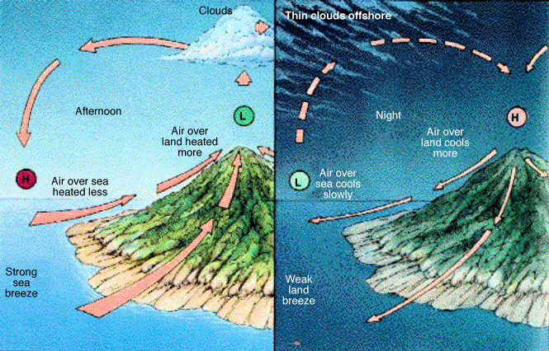
Heat exchange amongst Earth’s systems
TEMPERATURE DIFFERENCES AMONG AIR, WATER, AND LAND
Land heats and cools more rapidly than water.
Less energy is needed to raise the temperature of land than is needed to raise the temperature of water.
Also, land can heat to higher temperatures than water can. Land can also cool to lower temperatures than water can.
Heating and cooling of Earth’s land and water directly affect the air temperature above these surfaces.
That is, as water and land heat and cool, the air above the water and land heats and cools, too.
This process helps create winds.

Slide 9
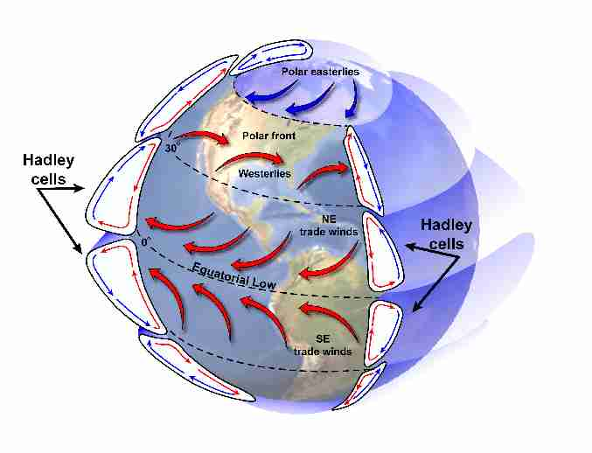
HOW DOES THE SUN’S ENERGY AFFECT GLOBAL WINDS?
- Energy provided by the sun influences global winds and creates temperature differences among Earth’s air, water, and land.
Global winds- are winds that blow steadily from specific directions over long distances.
- Like local winds, global winds are created by the unequal heating of Earth’s surface.
- Unlike local winds, global winds occur over a large area.
GLOBAL CONVECTION CURRENTS
- Temp. differences between the equator and the 2 poles produce giant convection currents in the atmosphere.
- These currents form as warm air rises at the equator and cold air sinks at the poles (convection).

Slide 10
Sample Question
Unusually cold winters are problematic for Florida’s manatees. Colder air temperatures lead to colder water, which lead to manatee illness and death. Fortunately, manatees can take shelter in warmer waters near natural springs and power plants. Which of the following accurately describes this chain of events leading to manatee illness?
A. Changes in the atmosphere cause changes to the hydrosphere, which affects the biosphere.
B. Changes in the hydrosphere cause changes to the biosphere, which affect the atmosphere.
C. Changes in the geosphere cause changes to the hydrosphere, which affects the atmosphere.
D. Changes in the atmosphere affect the cryosphere, which affects the hydrosphere.

Slide 11
Sample Question
The Sun’s energy travels through space to reach Earth. This energy supplies light and heat for the planet. Heat travels in several ways through Earth’s air, water, and land. Which of the following methods of heat transfer is an example of convection?
A. rays of sunlight reach Earth’s surface
B. warm air rises and displaces cooler air
C. heat moves from warmed asphalt into the air
D. heat moves from the top layer of soil to the lower layers

Slide 12
Sample Question
In December, Bill was driving through Florida with his family. As they drove closer to the coast, Bill noticed that the air grew a little warmer. Which of the following statements best explains the temperature difference?
A. Air expands at higher temperature
B. Water heats and cools more slowly than land does
C. Warm air moves toward the coastline from inland areas
D. Cool air moves from coastal areas to inland in a sea breeze.

Slide 13
Sample Question

Slide 14
Sample Question

Slide 15
Sample Question

Slide 16
Sample Question

